Slide 1
Customer Churn Prediction
A Machine Learning Approach

Slide 2
Synopsis
Introduction
Customer Churn
Understanding the data
Loading the Libraries
Data Manipulation
Data Visualization
Data Preprocessing
Building Machine Learning Model
Conclusion

Slide 3
Introduction
In this project on Customer Churn prediction, we examine the Churns which play a negative role in the growth of an organization. The reasons why the Customer leaves the services and products of an organization are very important for providing better user experiences and services for the customers thus it maintains the Customer- Relation Management. Thus, Prediction of the Customer Churn is very important for an organization to sustain itself in the growing technological world.

Slide 4

Customer Churn
Customer churn prediction is the process of using statistical and machine learning techniques to predict which customers are likely to stop using a company's product or service. By identifying these customers, businesses can take proactive measures to prevent them from leaving, such as improving customer service or offering personalized incentives.
Churn prediction models use historical data on customer behavior and characteristics to identify patterns and trends that are indicative of customer churn. This data may include transactional data, demographic information, customer support interactions, and other relevant data points.

Slide 5
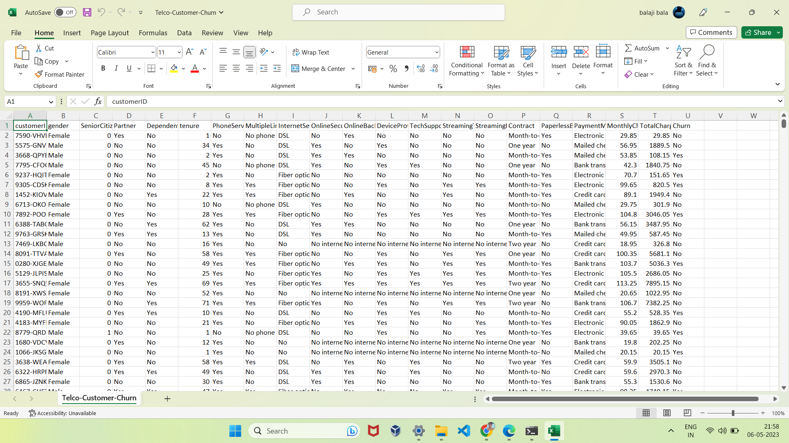
Telecom Customer Churn Dataset

Slide 6
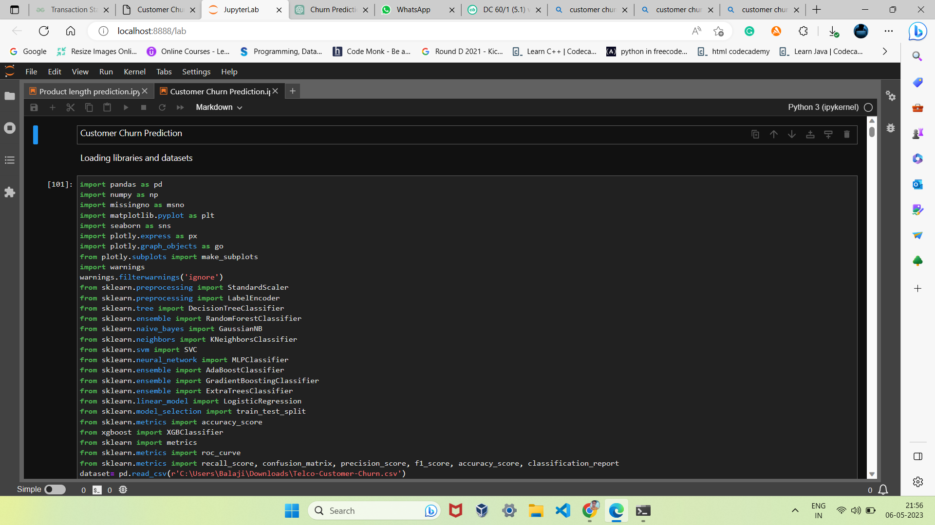
Loading the Libraries

Slide 7
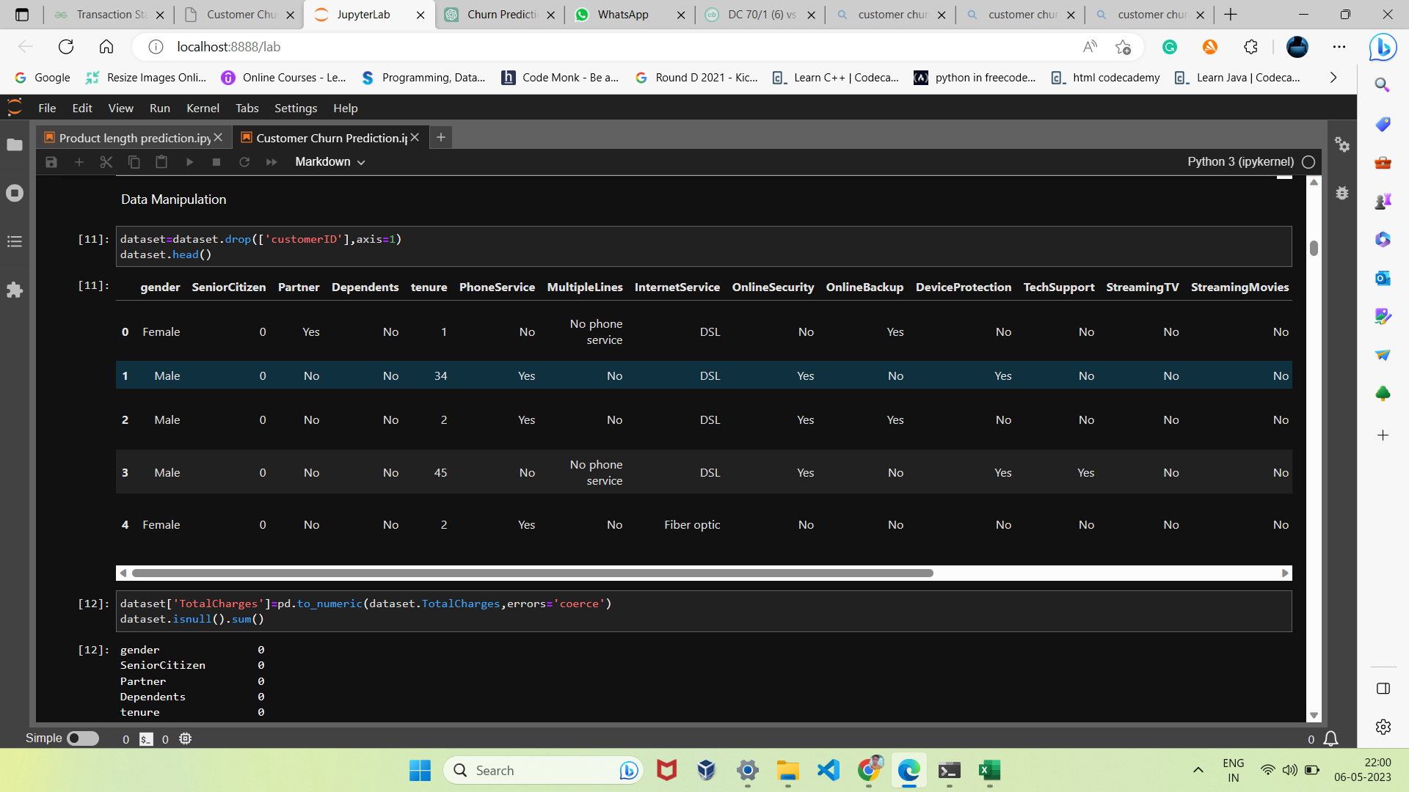
Data Manipulation

Slide 8
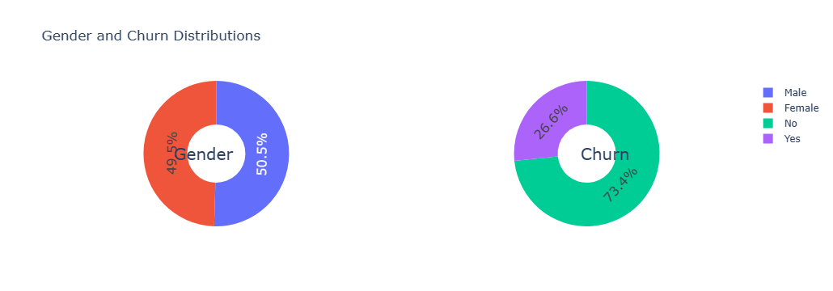
Data Visualization

Slide 9
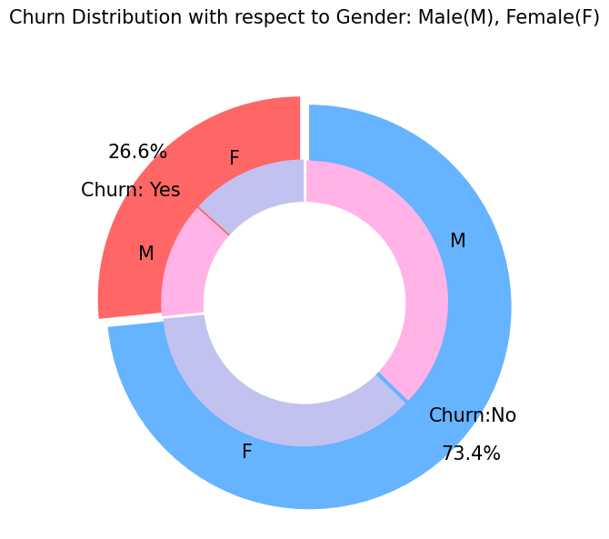
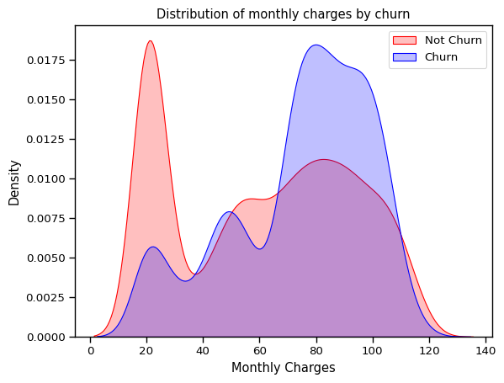

Slide 10
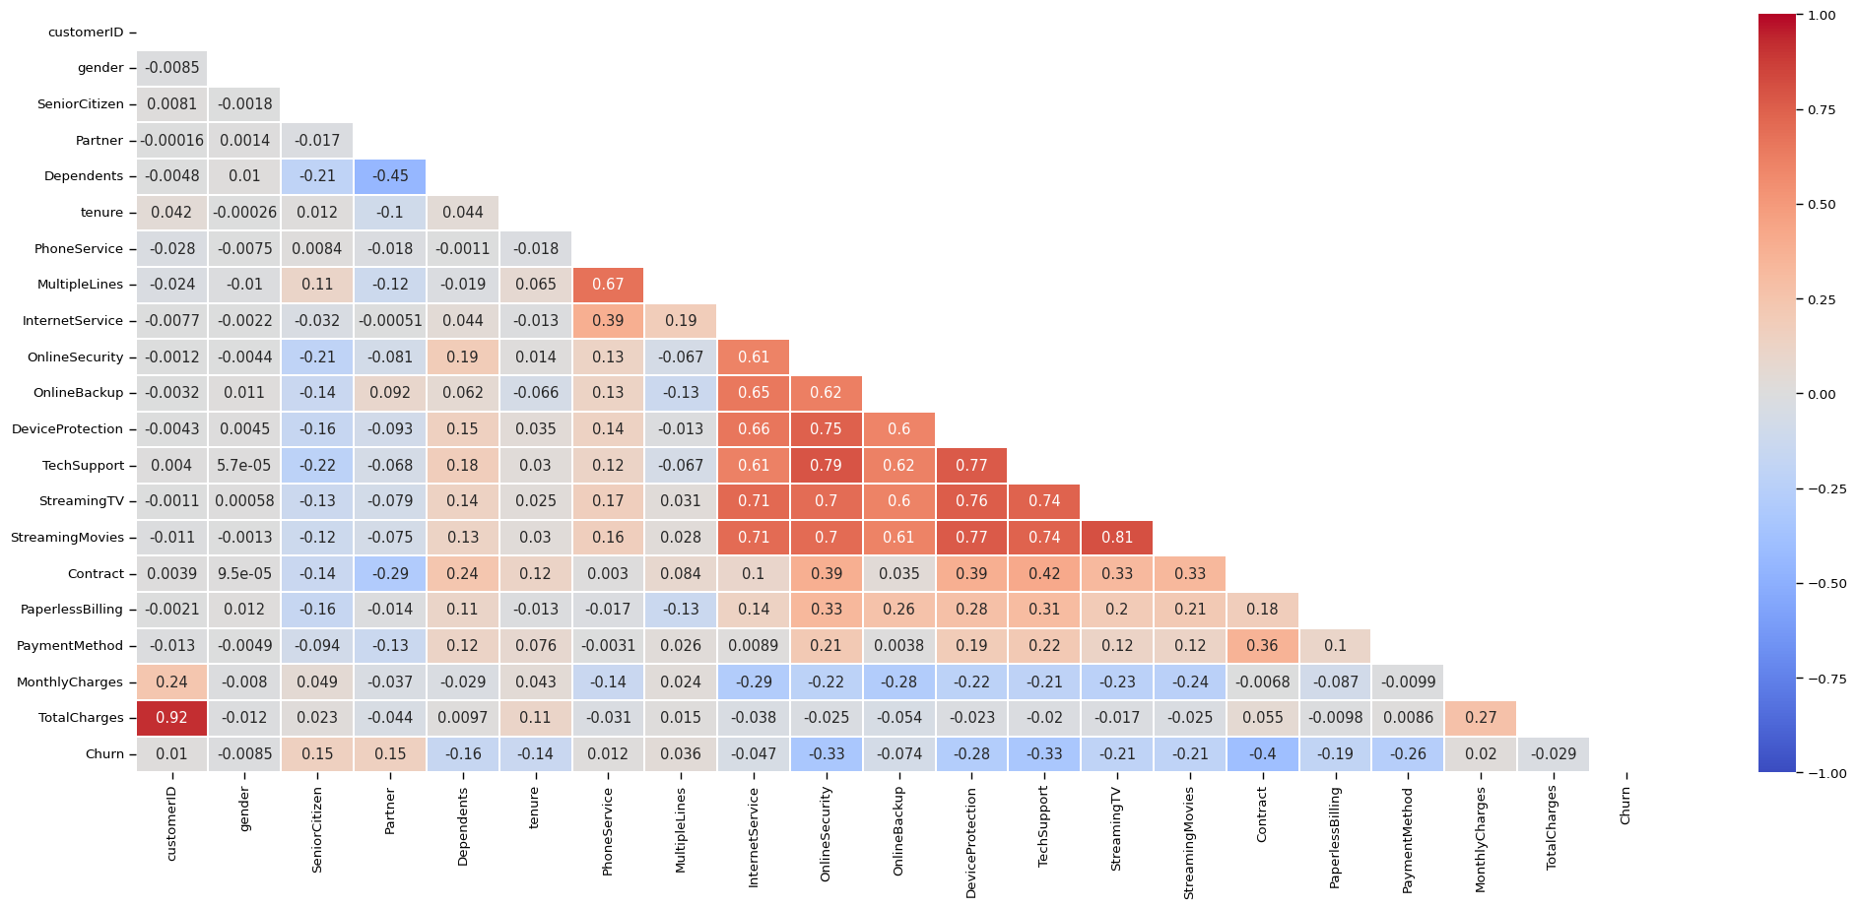
Heat Map

Slide 11
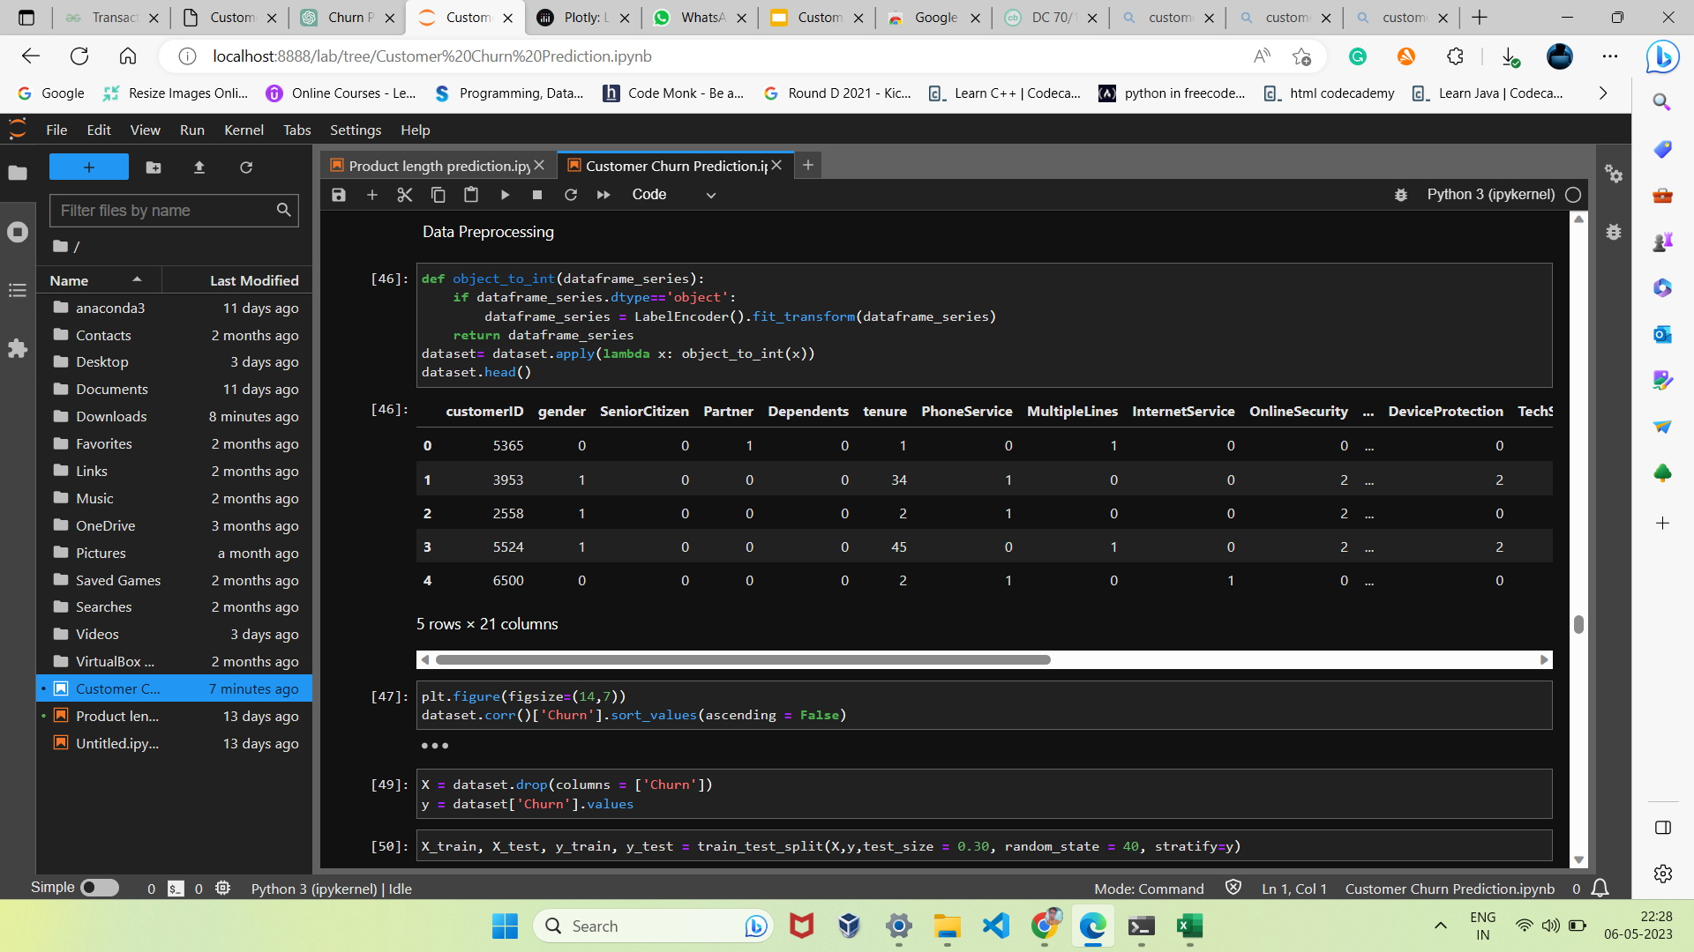
Data Preprocessing

Slide 12
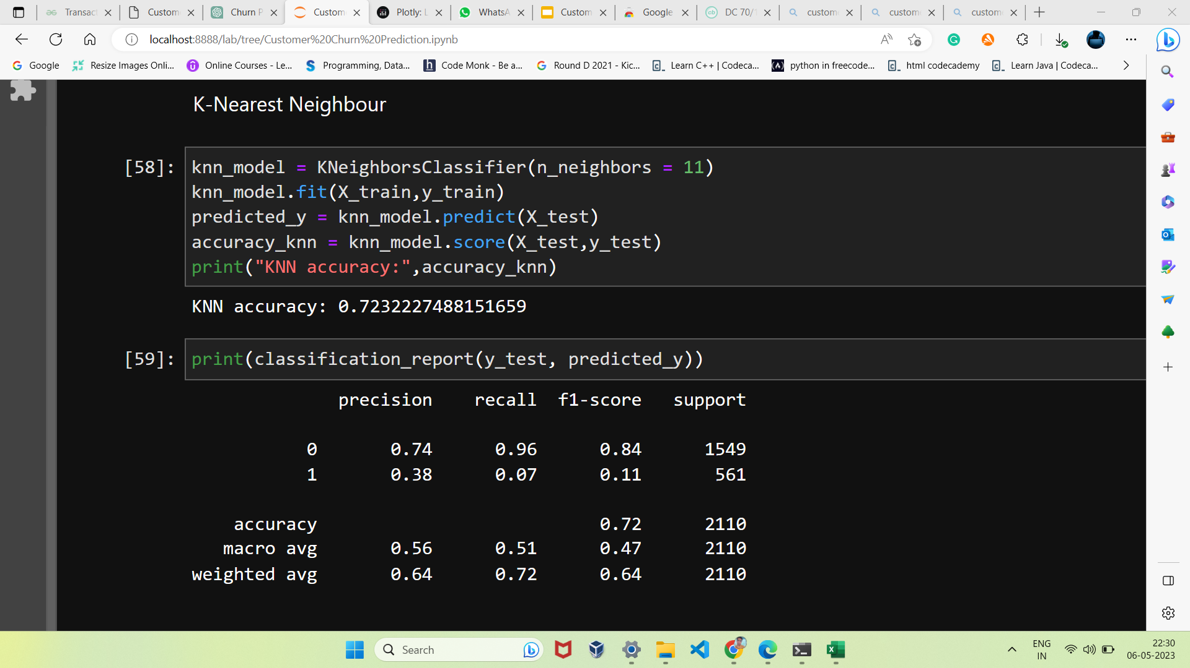
Machine Learning Model for Prediction
KNN

Slide 13
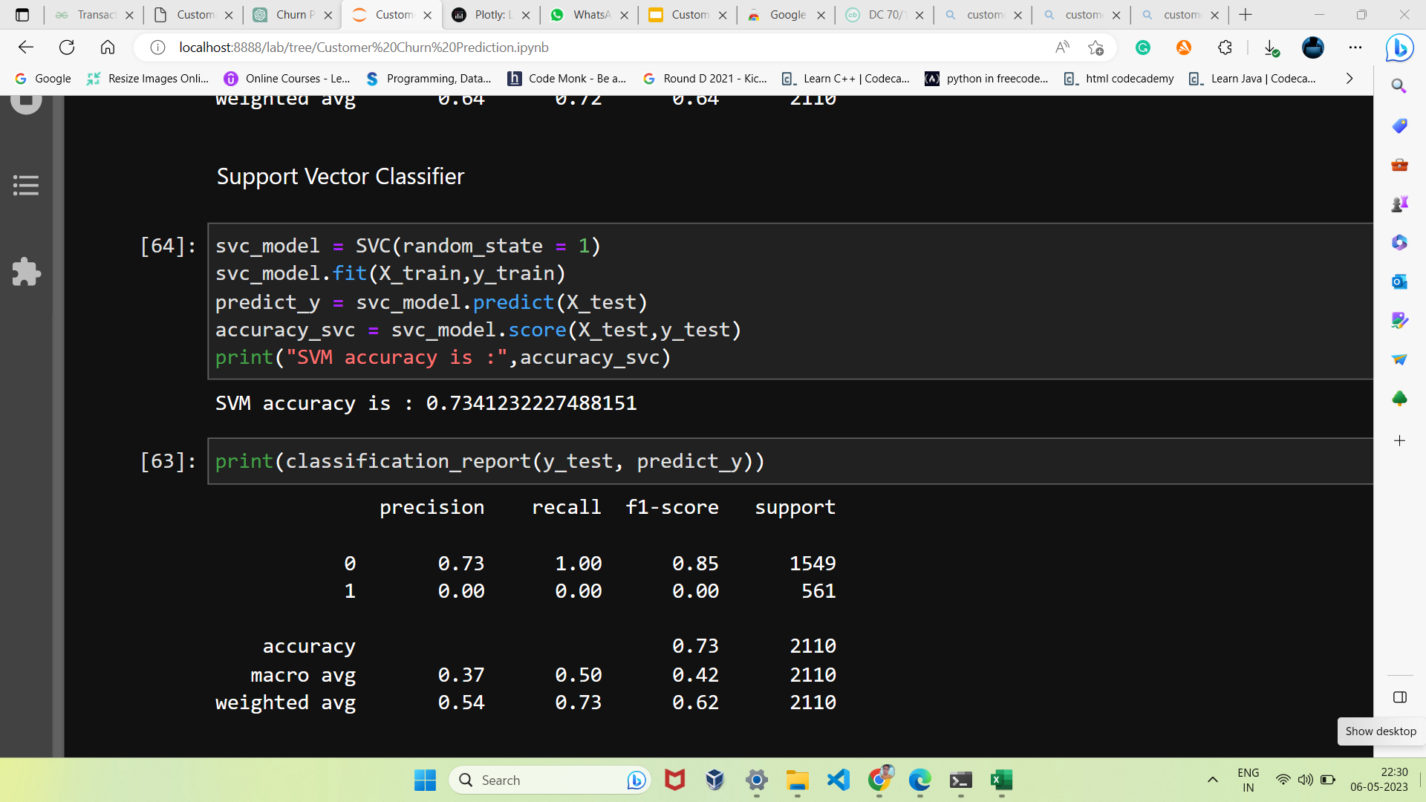
Support Vector Classifier

Slide 14
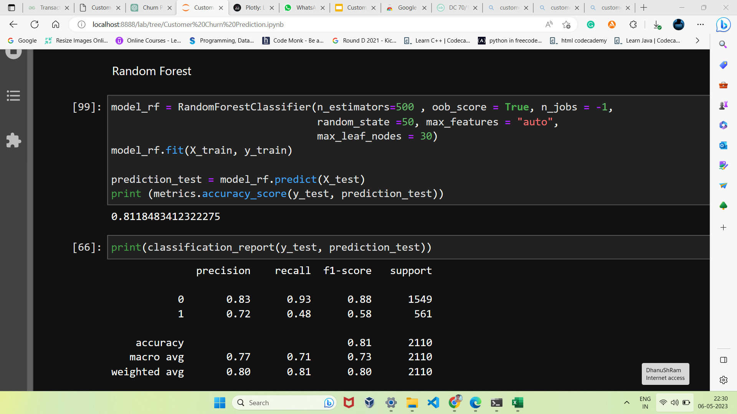
Random Forest

Slide 15
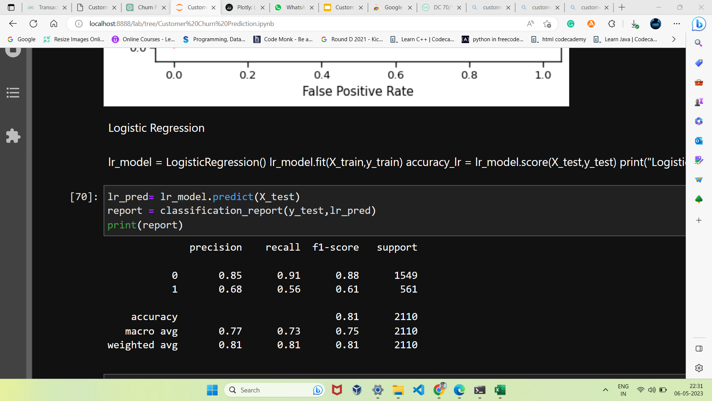
Logistic Regression

Slide 16
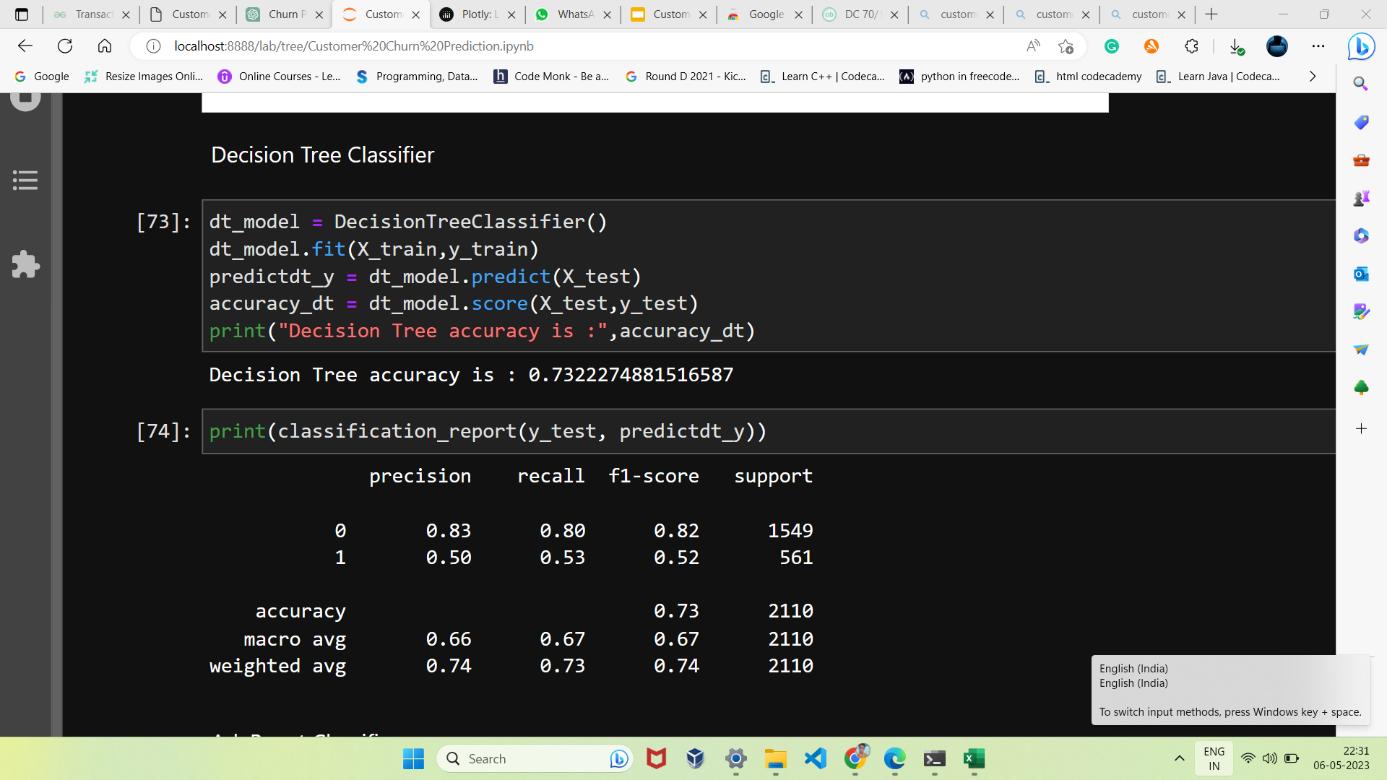
Decision Tree

Slide 17
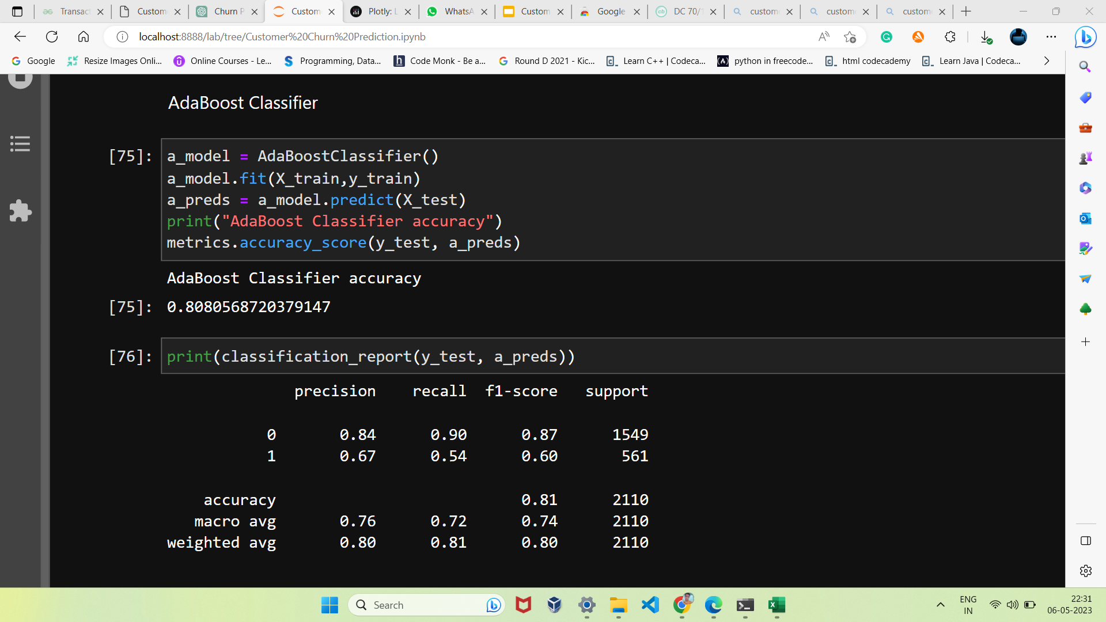
Adaboost Classifier

Slide 18
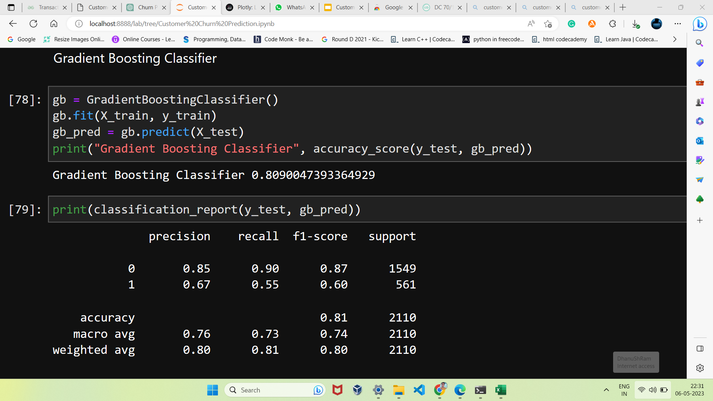
Gradient Boosting Classifier

Slide 19
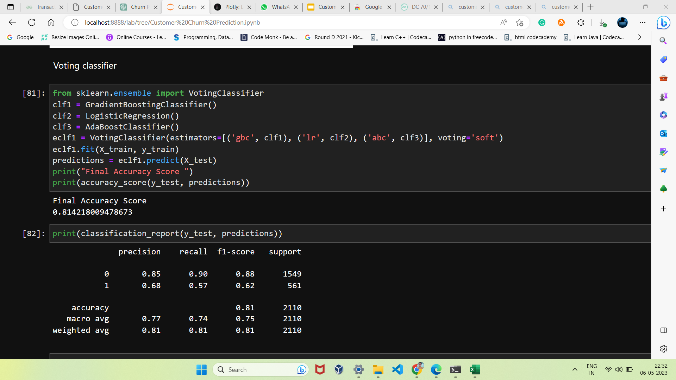
Voting Classifier

Slide 20
Conclusion
In Conclusion, Customer churn prediction is a powerful analytical technique that can help companies gain a competitive advantage and increase customer loyalty. By utilizing data-driven approaches, companies can anticipate and respond to customer needs, resulting in improved customer satisfaction, increased revenue, and reduced customer churn. It is a valuable investment for any business that wants to improve its customer relationship management and drive long-term growth.

Slide 21
Team Members
Goutham Kumar S
Dhanushram S
Balaji K
Department of Computer Science and Business Systems
Rajalakshmi Institute of Technology - Chennai

